Slide 1
The First Photo on Your Phone
IMF2A - Hokyee, Xylon, Lucas, Chester

Slide 2
Photo Categories
Questions
Portrait (selfies, family photos)
Street Photography (creative, artsy)
Landscapes
Life Based (reminders, food photos)
Why did you take this?
When did you take this?
Where did you take this?
Who is he/she?
Is this/he/she important to you?
What does this photo remind you of?

Slide 3
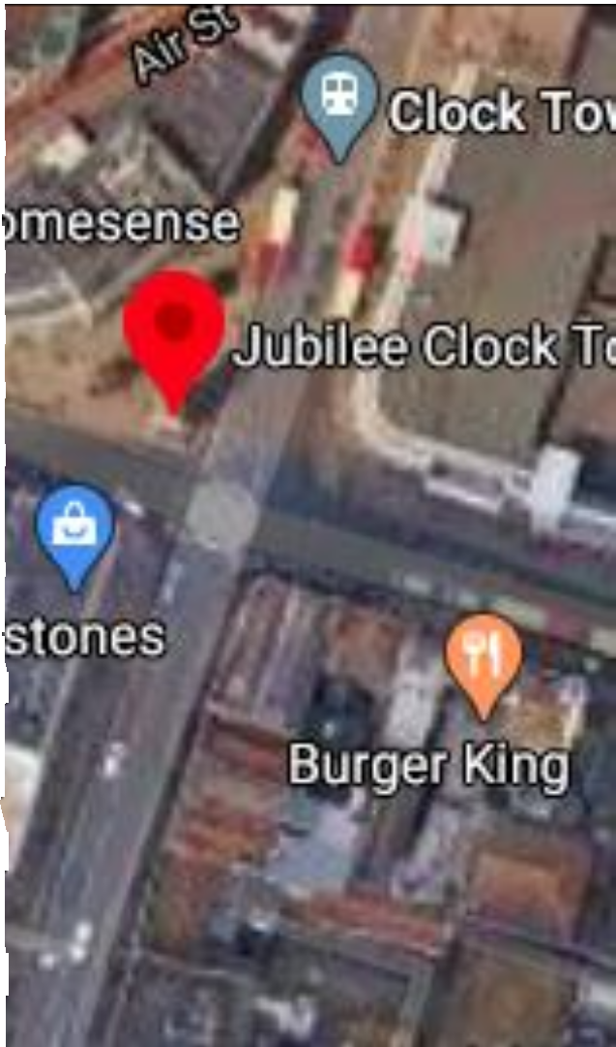
Places – Churchill square
Target Audiences:
High School Students – Youth
Shot Location:
Under Jubilee Clock Tower

Slide 4
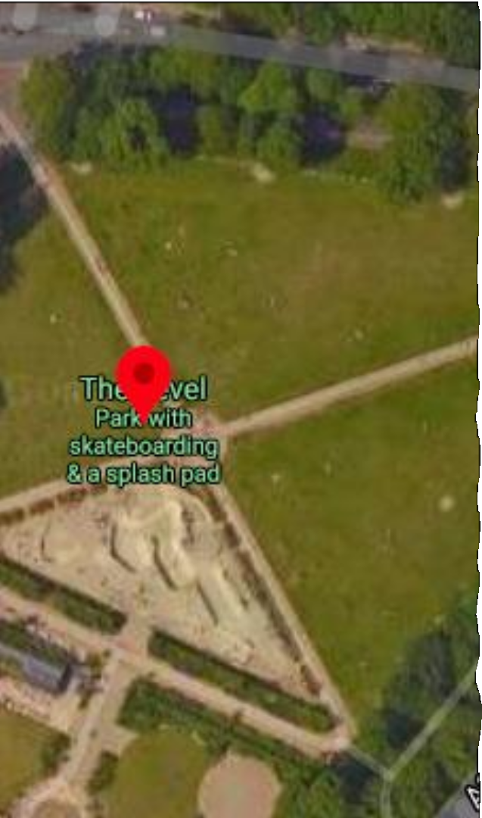
Places – The Level
Target Audiences:
Elderlies
Shot Location:
Anywhere in the park, most preferably on the grasslands

Slide 5
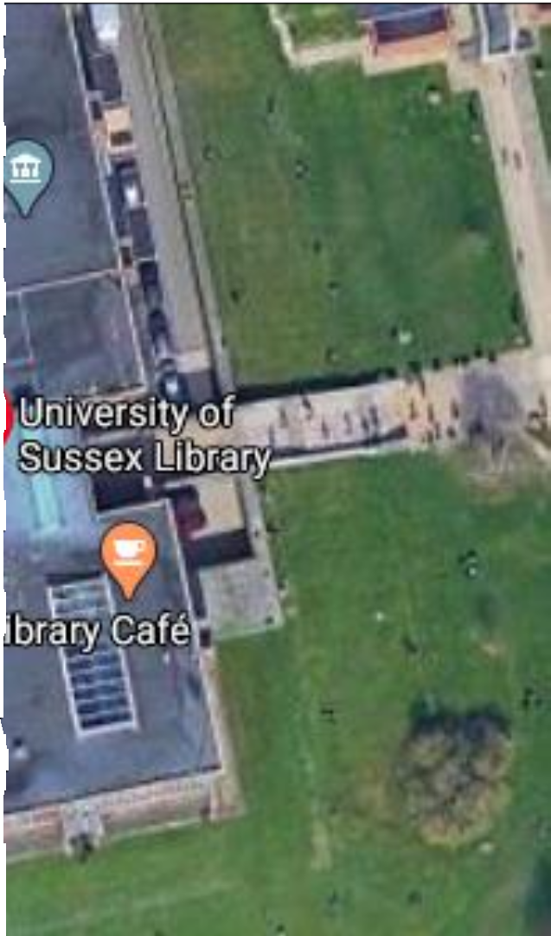
Places – School Library
Target Audiences:
Professors & University Students
Shot Location:
Under the stairs of the library or in Library Square

Slide 6
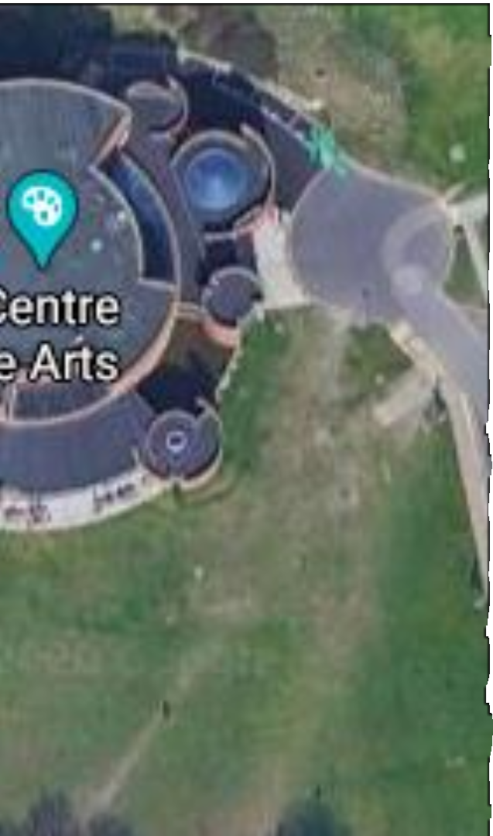
Places – Falmer Bar
Target Audiences:
University Students
Shot Location:
At the back door of Falmer Bar or in front of Attenborough Centre for the Creative Arts

Slide 7
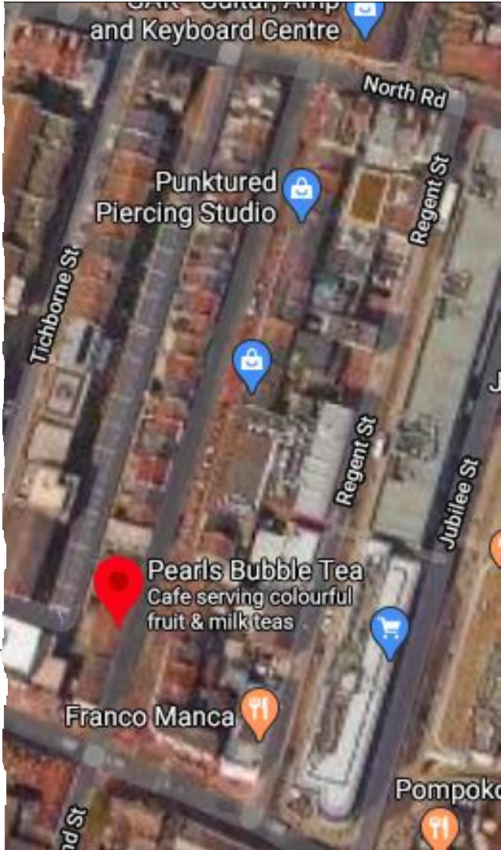
Places – Gardener street
Target Audiences:
Citizens and more fashionable people
Shot Location:
On the walking
(somewhere around Pearls Bubble Tea)

Slide 8
How to ask people
State our intentions
Ask questions
A small thank you gift

Slide 9

The rules of interview
Control your emotion
Focus on listening what interviewees say
Paraphrase what interviewee say to Check
Focus on the action taken by interviewees.
Answer questions by asking questions.
Make an conclusion.
Reference: Mo, Z., 2000. News interview and writing, Wuhan University Press.

Slide 10
Attention
Medium shot/Medium shot(over shoulder)
Backup everything
Cut on action
Avoid jump cuts with multiple camera angles
Notes:
1 The medium shot is most often used for conversational pieces, as the audience feels the subject is right there talking to them. However, documentary films frequently use close-ups of only a speaker’s head. This is common due to the varying sets and backgrounds that can be jarring when cutting between speakers.
2 Make sure you have already backed up your project. I suggest copying your folder structure onto an external hard drive. If you can, I’d keep that hard drive off site. Just in case there is a fire or theft, those files still exist somewhere els
3 If a shot is getting too static, go for an edit on physical action. Is the speaker using their hands a lot? Perhaps they turn their head to the side. These actions make perfect cutting points that seem natural.
4 When interviewed, many subjects will stumble on their words. Be prepared to cut out a lot of umms, uhhhs, and hmmms. You can hide these cuts by switching between angles. If the speaker is a chronic mumbler, then you may be cutting back and forth too much. You can cover these edits up with b-roll. Check out this posts on hiding jump cuts.
4

Slide 11
Director: Xylon
Interviewer: Hokyee
Voice recorder: Chester
Photographer: Xylon & Chester
Edit: Lucas
Staff
Introduction

